Slide 1
The ANTS problem

Slide 2
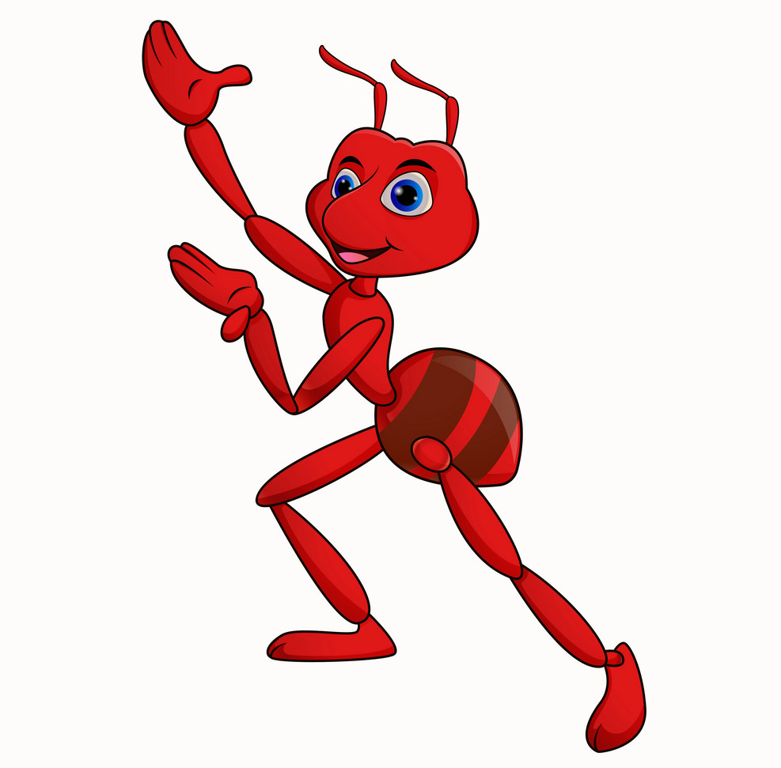
Ants Nearby Treasure Search (ANTS)
What is it?
How can we model it?
Goal of this paper
Algorithms
Takeaways

Slide 3
The Ants problem?
How do ants search?
How long does it take?
# of searchers matters?

Slide 4
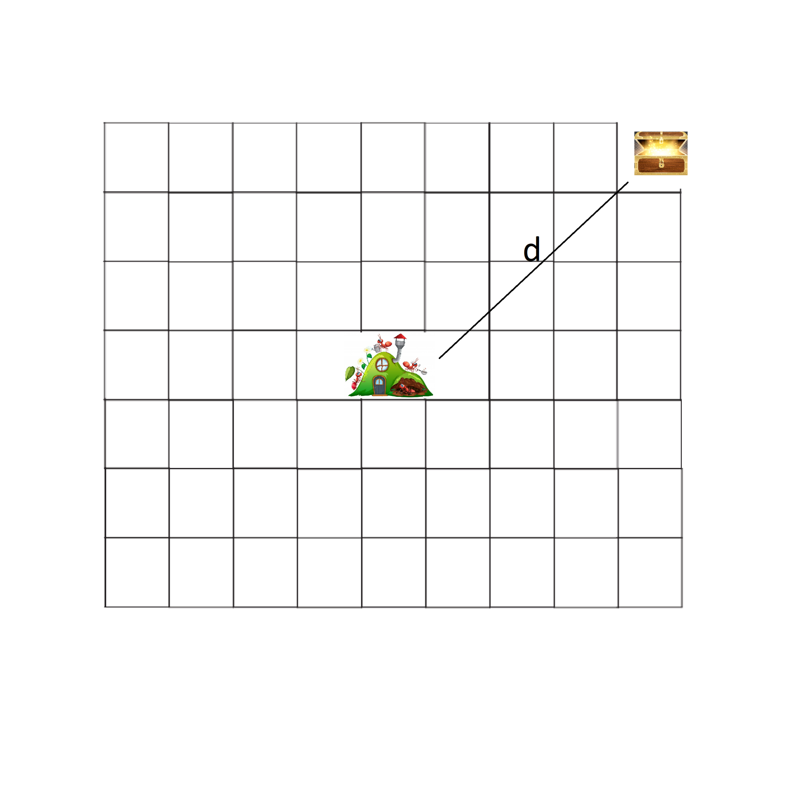
Model
The map
The food
The searchers/agents
Communication
Time

Slide 5
Communication
Different models:
Continuous communication
No communication
Only communication in the nest
Different choices can be made here

Slide 6
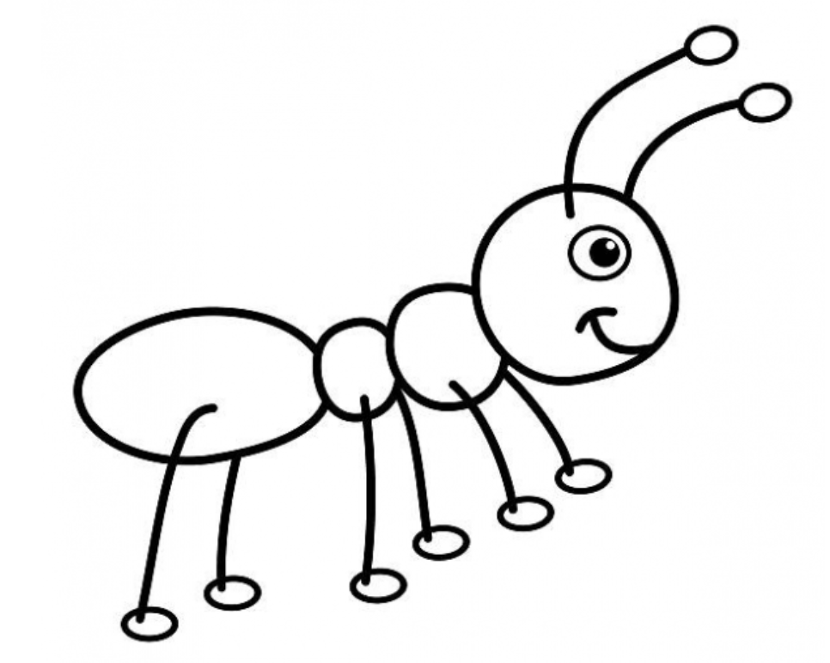
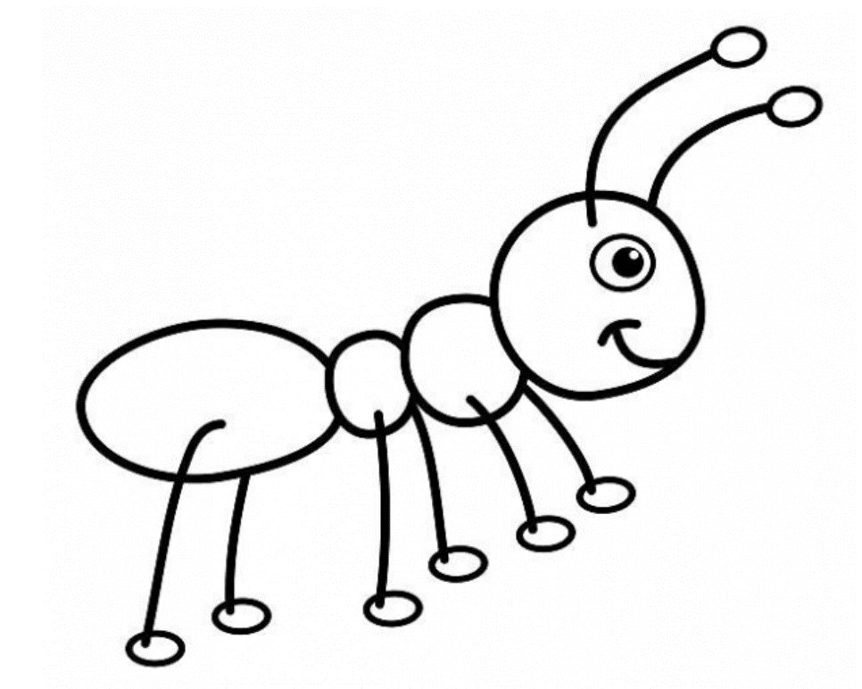
Communication model
Give me a random node
We will choose the last one
Centralised probabilistic algorithm/Oracle
Advice and advice size
First intuition:
-more information =>
-faster/better result
(13,25)

Slide 7
Find the first lower bound in time
1 time unit to traverse 1 field on the map
First lower bound on the time?

Slide 8
Goals
Advice size ≈ Running time ?
Numer of ants ≈ Running time ?
A ton of different algorithms
A ton of different lower/upper/tight bounds
Connection between theoretical CS
and Biology

Slide 9
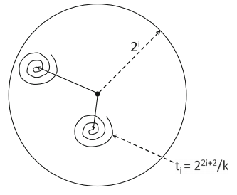
Algorithm using advice loglog(k)
Pseudo code:
Each agent perfoms the following double loop
for j from 1 to ∞ do
for i from 1 to j do
end
end

Slide 10
Algorithm using advice loglog(k)
i ….. Is called the phase/stage i
„Search ball“ gets bigger each phase
Each „Search spiral“ gets bigger each phase
Denote s = log D
i is called a large phase if i >= s
As 2 to the power of log D … is D
This means that in a large phase treasure is included
In the „ search ball “

Slide 11
Algorithm using advice loglog(k)
This algorithm is O(1)-competitive!

Slide 12
C-competitiveness
An algorithm is c-competitive if its time complexity is at most c times the straightforward lower bound.
A c-competitive algorithm in this case runs in at most c*(D+D^2/k)
log(k)-competitive … means it runs in O(log k * (D+D^2/k))
k- competitive … it runs in O(k* (D+D^2/k))

Slide 13
Algorithm using advice loglog(k)
This algorithm is O(1)-competitive!

Slide 14
Analysis
Treasure ball
P(choosing node near the treasure) is
β/k… for β some constant
P(no agent found the treasure) is
L is the number of large phases done by each agent

Slide 15
Ingredients for conclusion
1. With P(no agent found the treasure)
2. Time it takes to complete phase i
for j stages + hide constants

Slide 16
Algorithm using advice loglog(k)
This algorithm is O(1)-competitive!
Hurray! We did it
But what does this mean now??

Slide 17
Conclusions
What to do with the lower bounds/upper bounds
What did the paper overall achieve?
Biologal systems Theoretical C.S.
What more can be done?

Slide 18
Questions?

